Slide 1
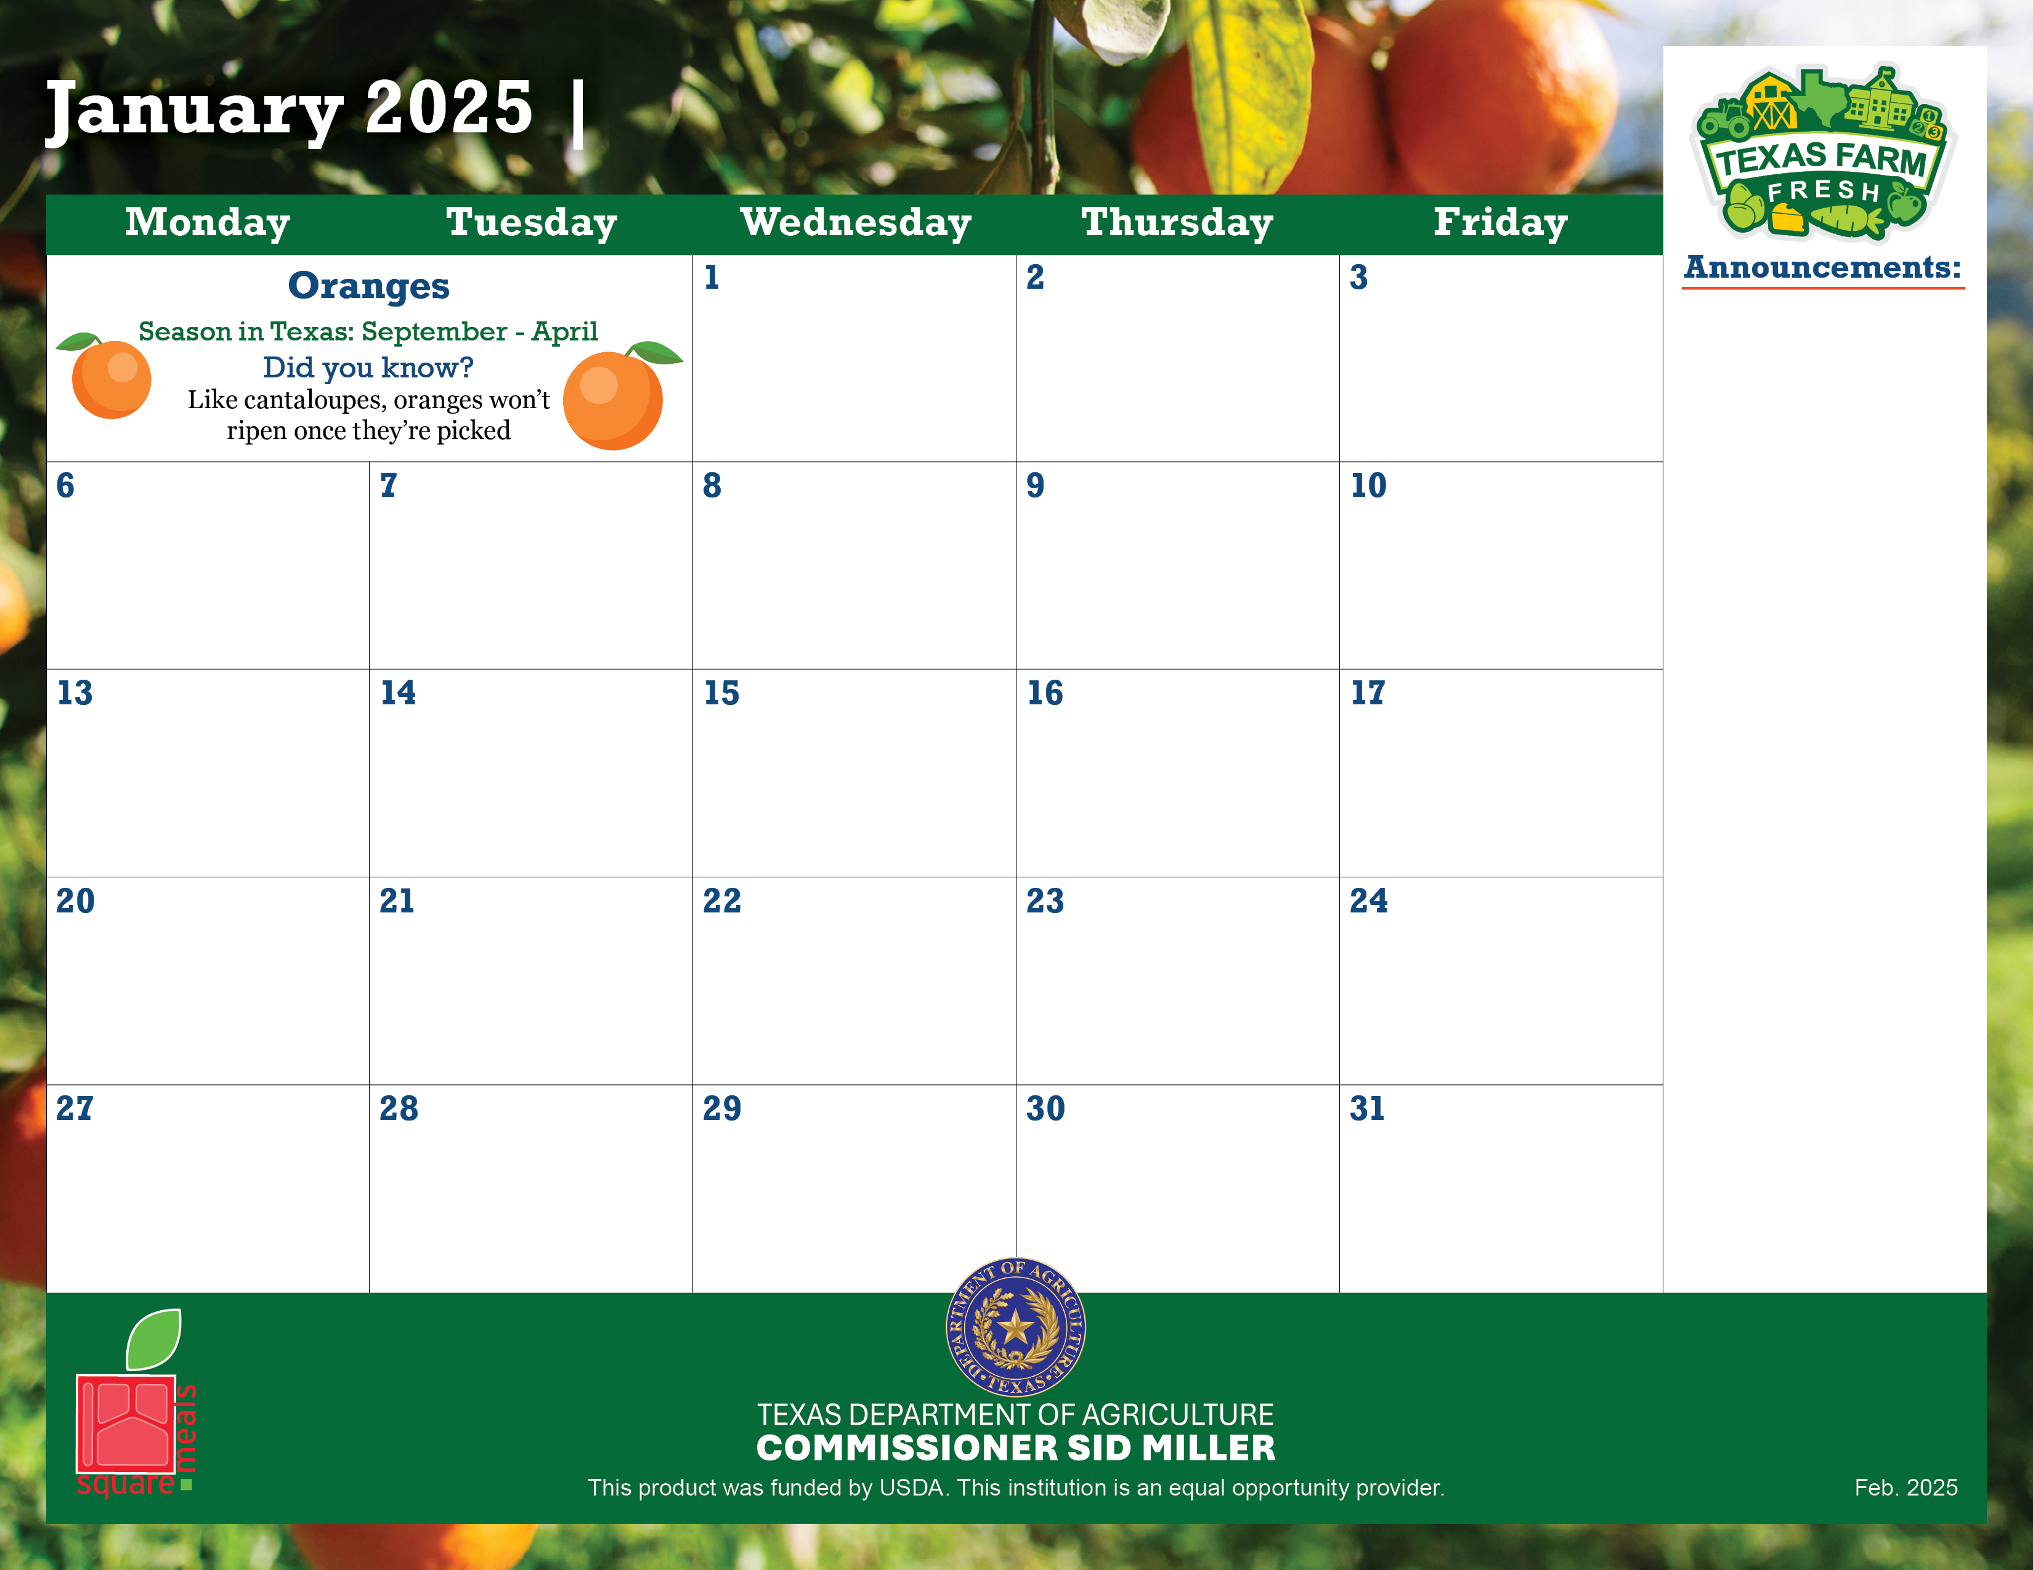

Announcement text goes here.
Copy and paste the Texas icon as many times as you need to place on the days your menu features Texas products!

Slide 2
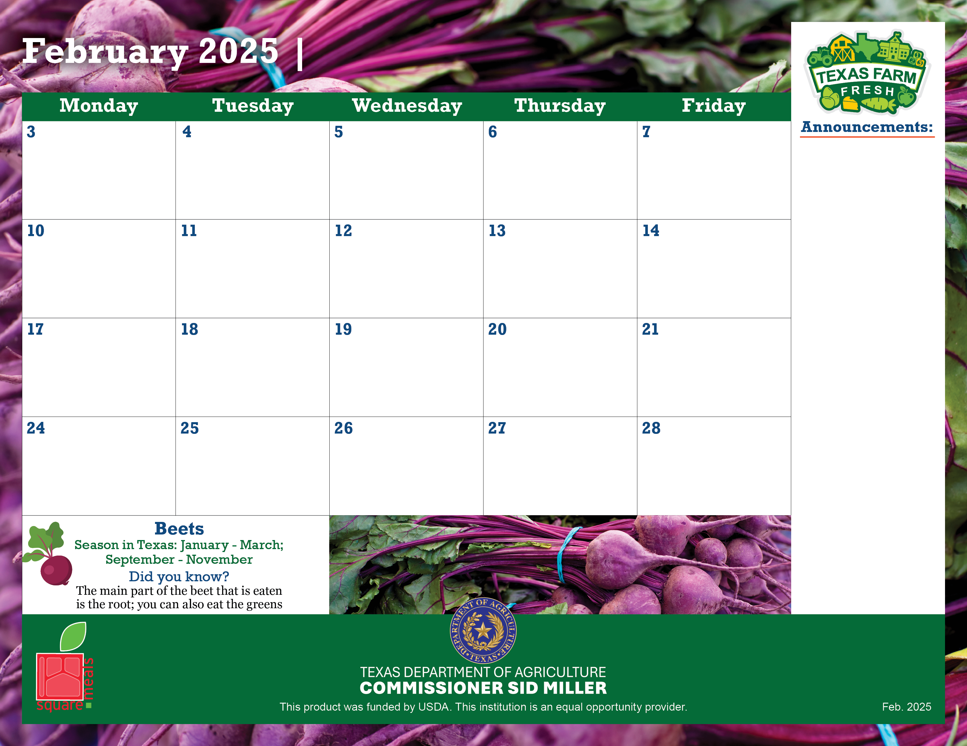
Announcement text goes here.
Copy and paste the Texas icon as many times as you need to place on the days your menu features Texas products!

Slide 3
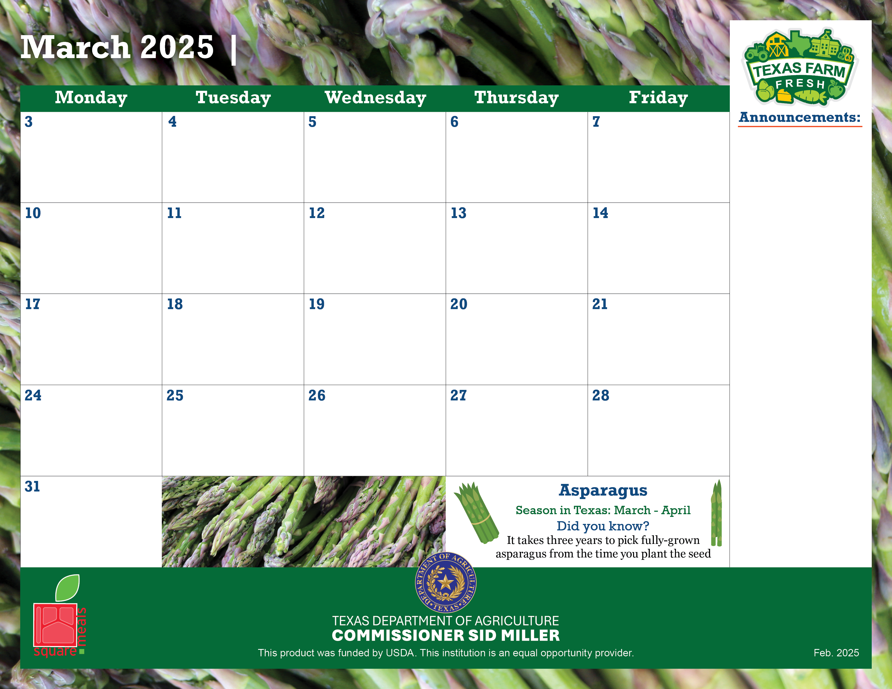
Announcement text goes here.
Copy and paste the Texas icon as many times as you need to place on the days your menu features Texas products!

Slide 4
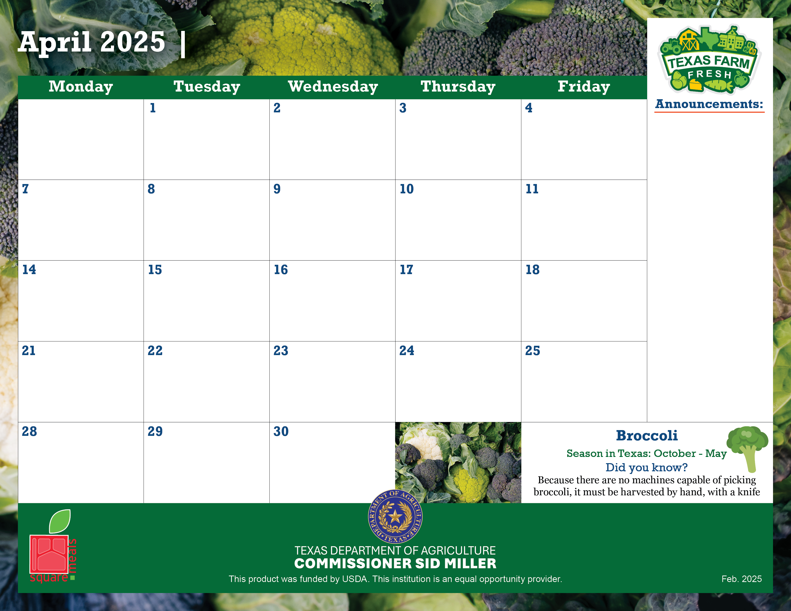
Announcement text goes here.
Copy and paste the Texas icon as many times as you need to place on the days your menu features Texas products!

Slide 5
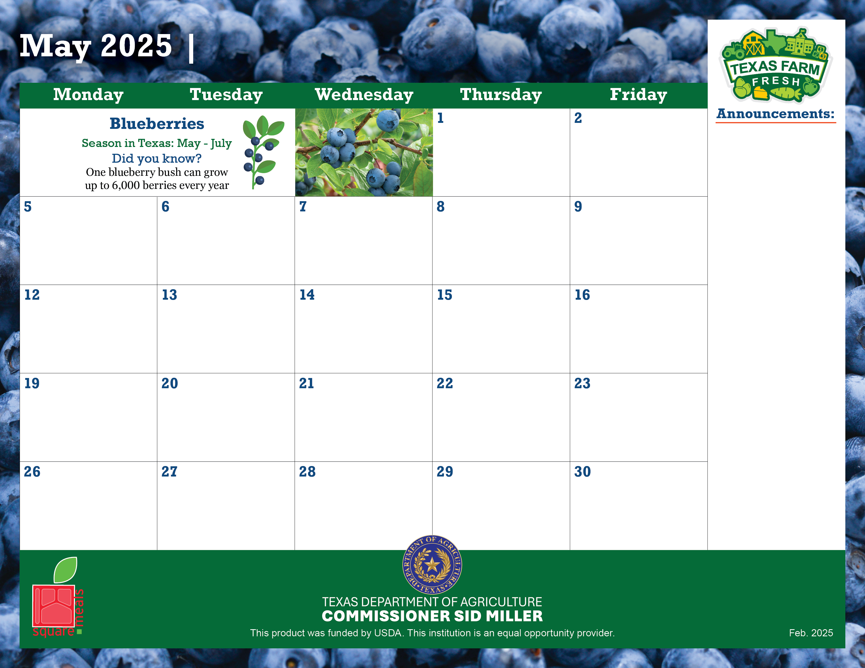
Announcement text goes here.
Copy and paste the Texas icon as many times as you need to place on the days your menu features Texas products!

Slide 6
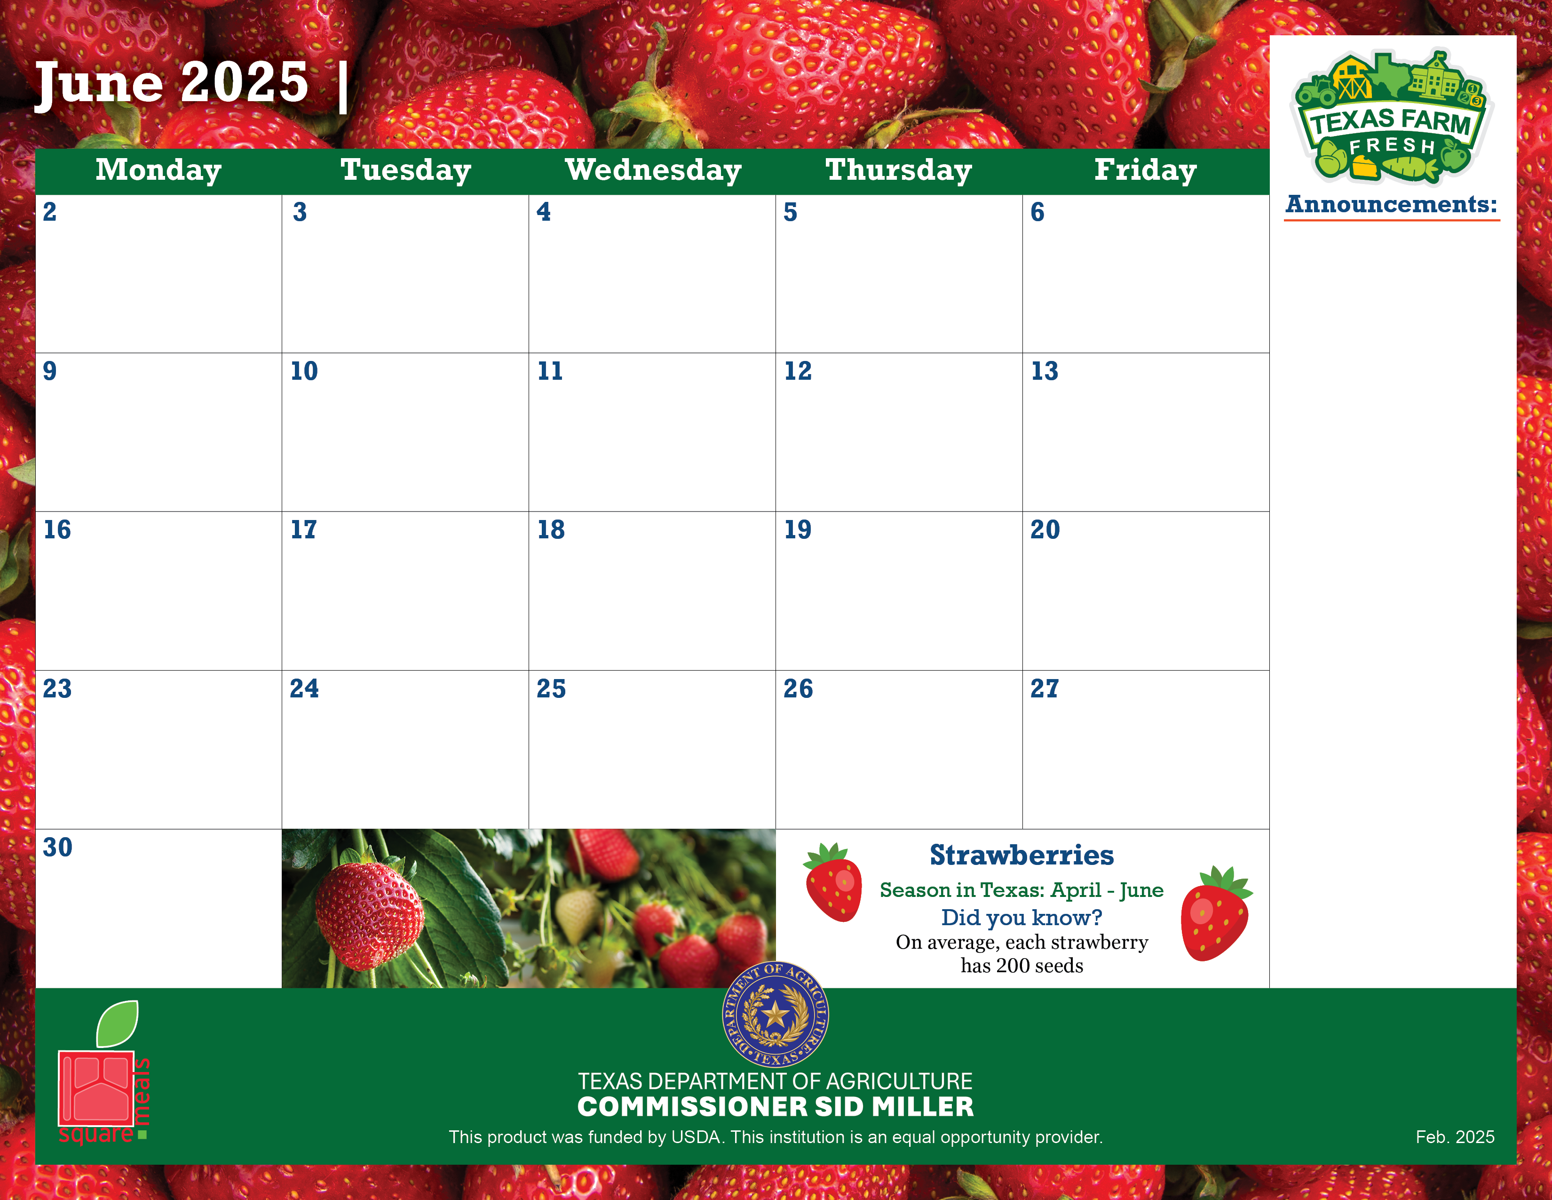

Slide 7
